Slide 1
3 Axis Pin Dev. Update
Week #12

Slide 2
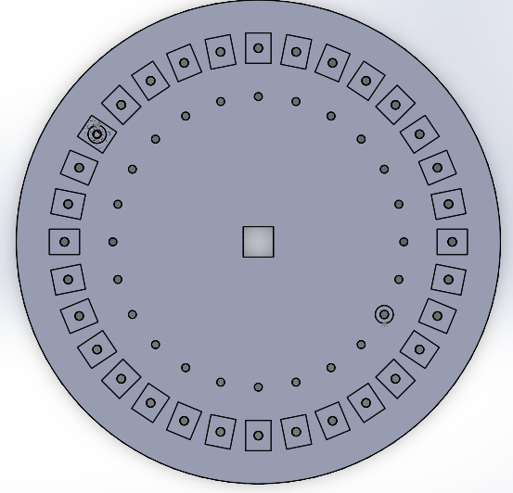
Stringing!

Slide 3
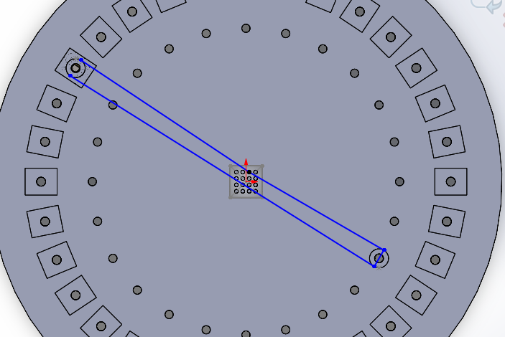
Possible Stringing 1!

Slide 4
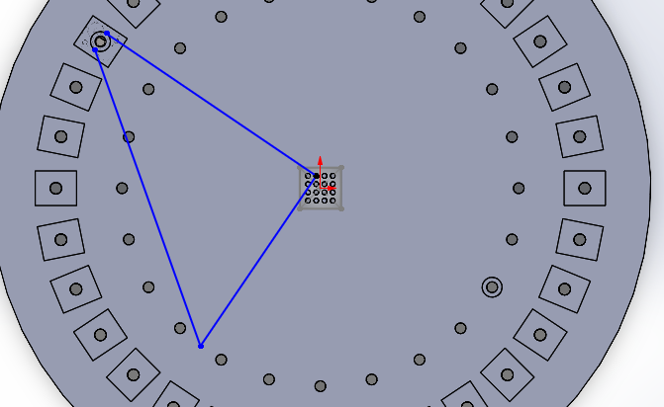
Possible Stringing 2!

Slide 5
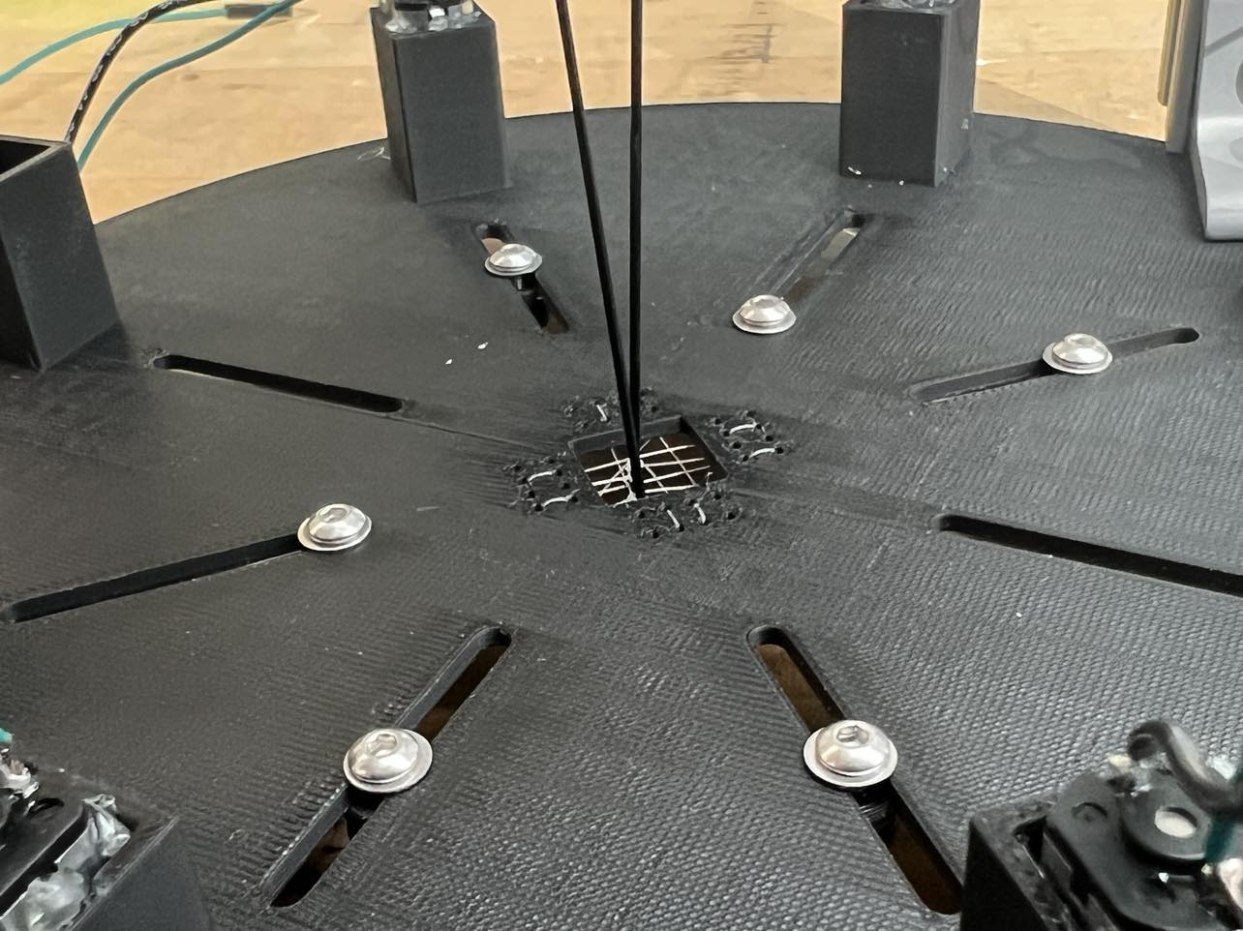
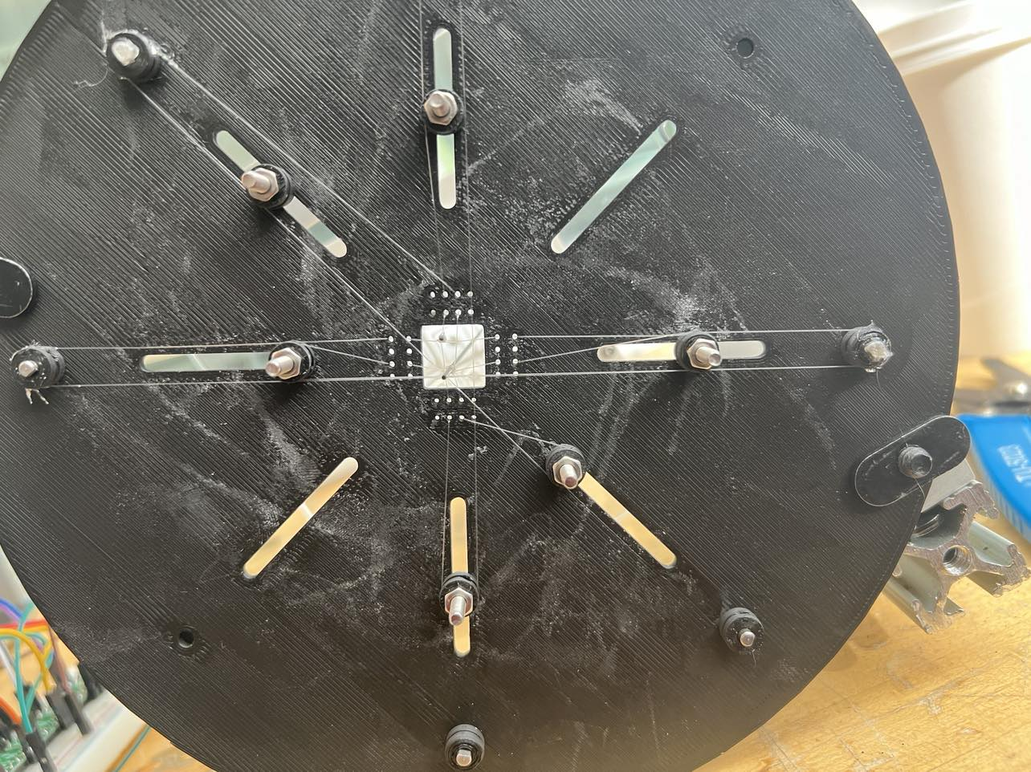
Physical Stringing!

